Slide 1
Summer R Workshop 1
Matthew D. Turner
mturner46@gsu.edu
Department of Psychology
Georgia State University

Slide 2
What is R?
R is a variant of the S programming language
The S language was developed in 1976 at Bell Labs
It was designed for data analysis and statistical modeling
S Developers: Rick Becker, Allan Wilks, John Chambers
S was developed by people working on particularly hard data analysis problems where standard solutions did not usually apply
S Goal: “to turn ideas into software, quickly and faithfully” (Chambers)

Slide 3
What is R?
R was developed by Ross Ihaka and Robert Gentleman at University of Auckland, New Zealand
It is an open source version of the commercial language S-Plus
S-Plus was an earlier derivative of S developed by Statistical Sciences, Inc. (SF, CA)
S-Plus introduces many features not in the original S (much of the OOP system)
S-Plus was basically made non-viable as a commercial product due to R
R is now the dominant dialect of this family of S based languages

Slide 4
What is R?
R is now an international project
R language is controlled by the R Core Team
Managed by the R Consortium: www.r-consortium.org
Shared/Delivered by CRAN: cran.r-project.org
Package development is shared by the global R community

Slide 5
What is R?
For most people:
R is a statistics language
It is designed for working with data
It is the Koine of the data science and statistics worlds
Most new statistics are implemented in R before they are elsewhere
It is also heavily used in the new data industries
Machine learning for large data sets
Deploying “dashboards” for corporate analytics
Exploring massive databases

Slide 6
What is R?
Language Features:
Interpreted (not compiled or batch)
Interactive use is the default
It is hard to imagine this not being true these days! But in 1976 SAS used punch cards
Multi-paradigm:
Procedural with Functions (somewhat “functional”)
Object-oriented (OOP) with Generic Functions, with full method dispatch; ex: summary()
Two types of objects S3/S4 – not compatible with each other (Ugh!)
With full APL-style support for arrays (column order matrix operations)
So implements full linear algebra like Matlab, IDL, or PV-WAVE
Many operations are properly vectorized

Slide 7
What is R?
S is an opinionated language, it emphasizes:
Data Flow
“Exploratory data analysis” (Tukey’s ill-conceived term)
Quick/Exploratory Graphics
Easy mathematical manipulations in models
Programmatic interface to analysis (functional archetypes)

Slide 8
What is R?
R is an evolutionary product
Many of its features only make sense if you know the history
“Vestigial” components abound!
R is stable
There have been no substantial changes to the core language in years
Code written years ago still (mostly) works
Most Development in R takes place in packages/libraries
Because R is a language, you can add new features to it
The language stays constant
Different packages/combinations of packages give the new or different features

Slide 9
Jupyter Notebooks
There are two common styles of interface to scientific computing software
Window-pane GUI AKA Matlab-style
Notebooks AKA Mathematica-style

Slide 11
Graphics appear in another pane like here.
Enter commands here into a “script” file.
See results of commands in this window.

Slide 12
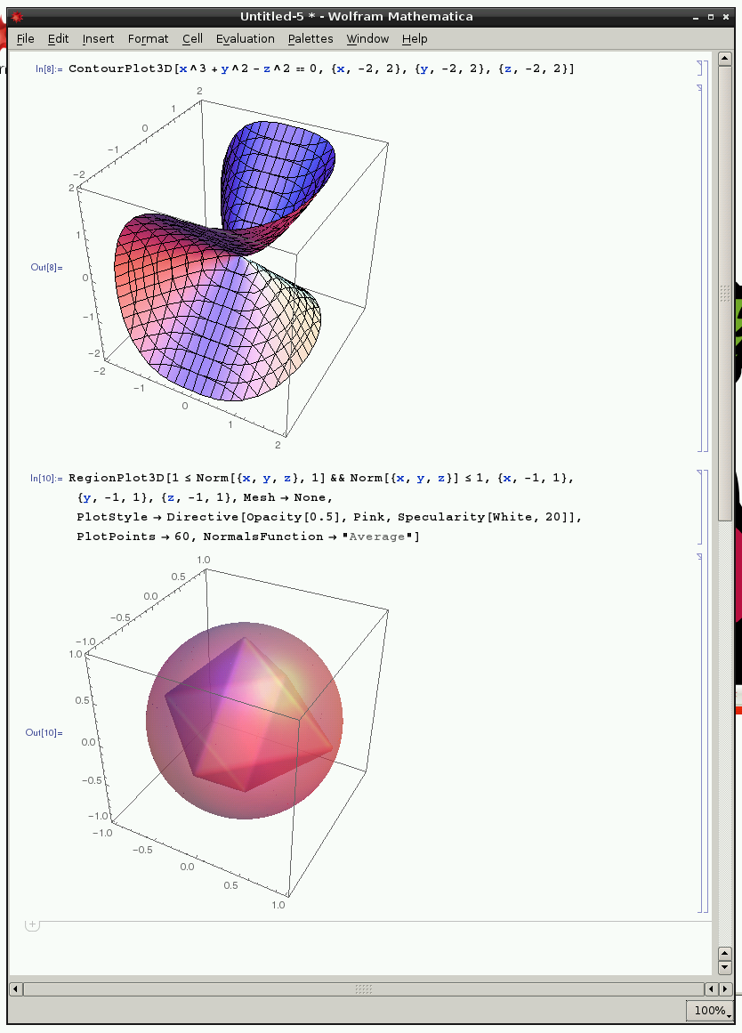
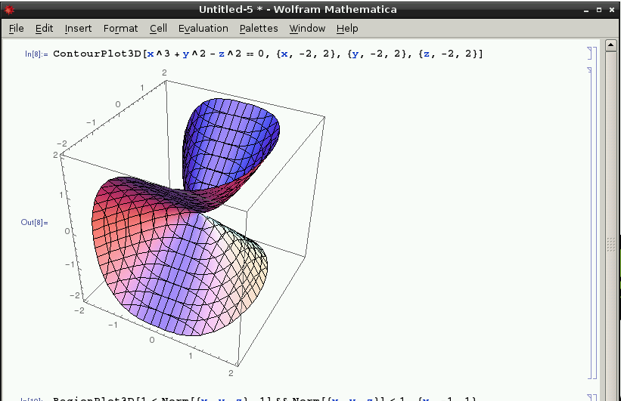

Slide 13
Everything appears in one window, in sequence.
Each input is followed by…
…its corresponding output.

Slide 14
Jupyter Notebooks
There are two common styles of interface to scientific computing software
Window-pane GUI AKA Matlab-style
Notebooks AKA Mathematica-style
For R both are available
RStudio implements the Matlab-style interface
Jupyter implements the Mathematica-style interface
Note that R is the SAME in both!
Both RStudio and Jupyter use exactly the same R “server” underneath
Same language, same implementation, same everything

Slide 15
Scientific Software Architecture
Client
Browser / Interface
Commands
Server
R Server / Other
Graphs/Results
The server part of this can be located anywhere you are connected to:
On the internet (like today): https://dice.gsu.edu:8000/hub/login
On the same computer as the client: http://localhost:5000

Slide 16
Scientific Software Architecture
Client
Browser / Interface
Commands
Server
R Server / Other
One nice feature of this design is that it works cross-platform – that is, PC/Mac/Linux works the same.
Graphs/Results
The server part of this can be located anywhere you are connected to:
On the internet (like today): https://dice.gsu.edu:8000/hub/login
On the same computer as the client: http://localhost:5000

Slide 17
Jupyter Notebooks
If you like Jupyter it supports most scientific programming languages:
Old timey: FORTRAN (coarray-fortran 2008)
Statistics programming: SAS, R, Incanter/Clojure
Math programming: Matlab, Julia (IJulia), Maxima,
Plotting/Graphics: Gnuplot, D3/Javascript
AI: prolog, smalltalk, Mathematica, scheme (LISP dialect)
Web languages: Ruby, Haskell, Javascript, Coffeescript
System languages: C, Go, Scala, Erlang, bash, Kotlin,
And many more
https://github.com/jupyter/jupyter/wiki/Jupyter-kernels

Slide 18
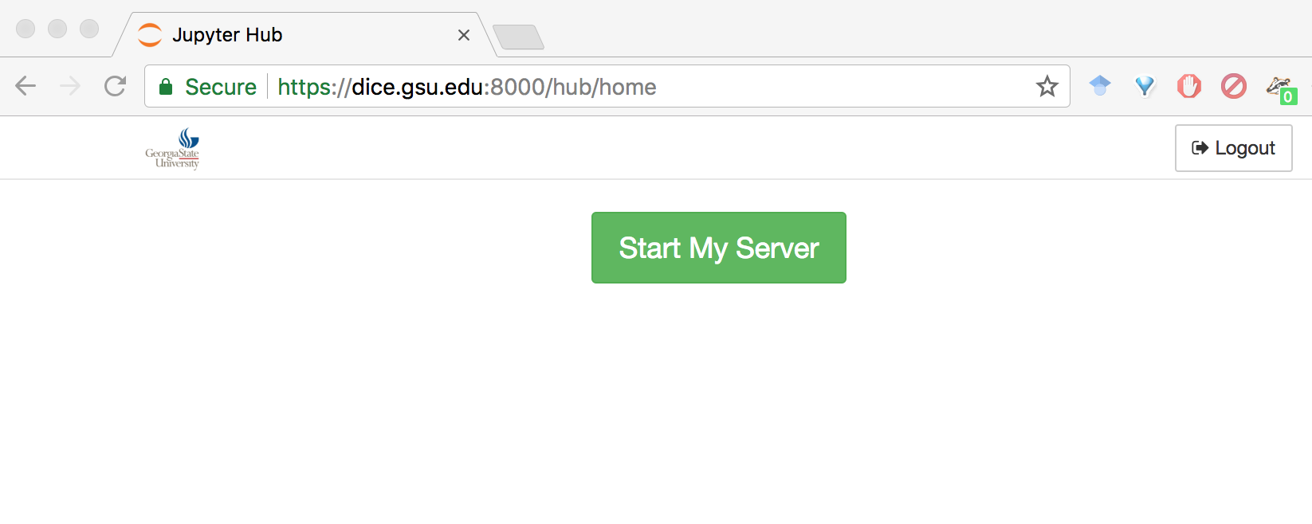
Workshop
Log into DICE:
https://dice.gsu.edu:8000/hub/login
The minimal address: dice.gsu.edu:8000 should work, but sometimes does not
Then you see this:
Click the “Start My Server” button.

Slide 19
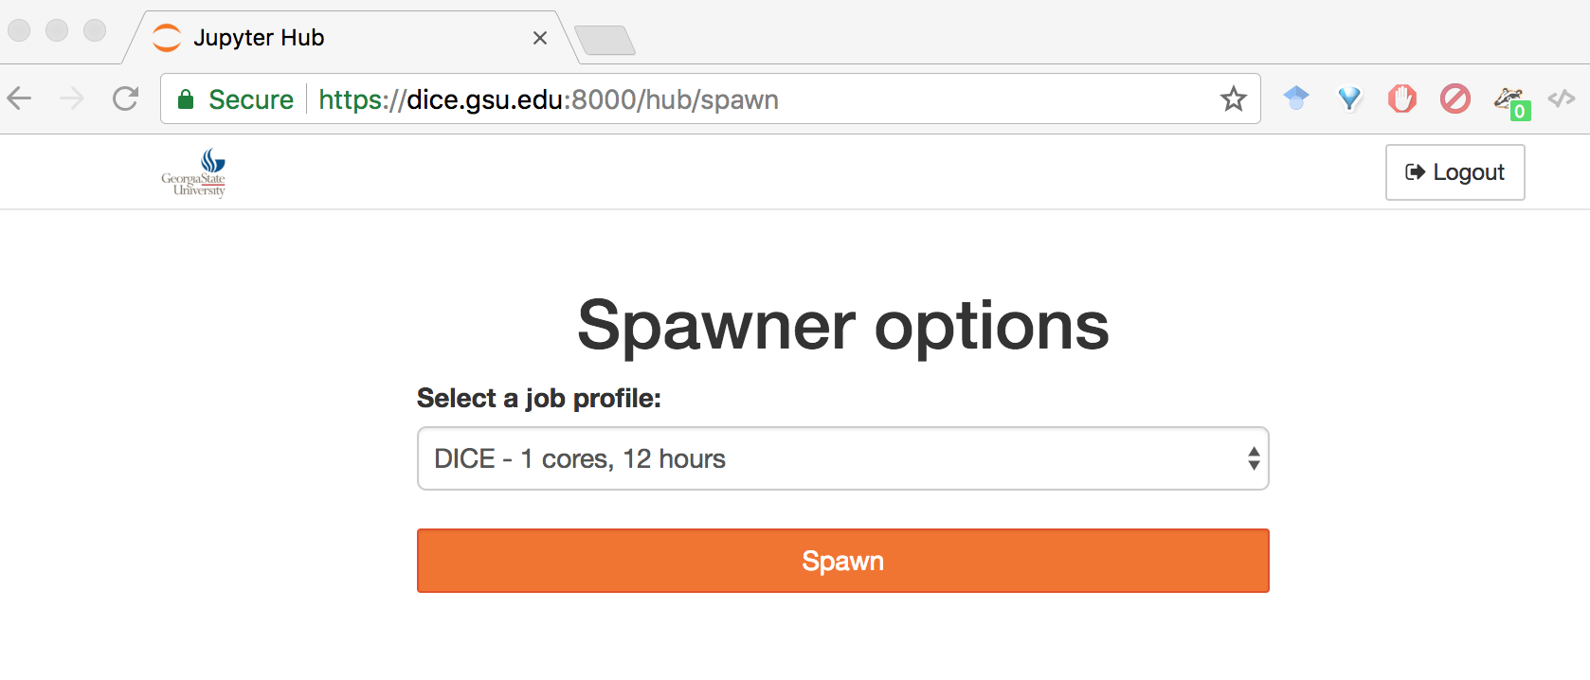
Click the “Spawn” button ONCE. Then wait…

Slide 20
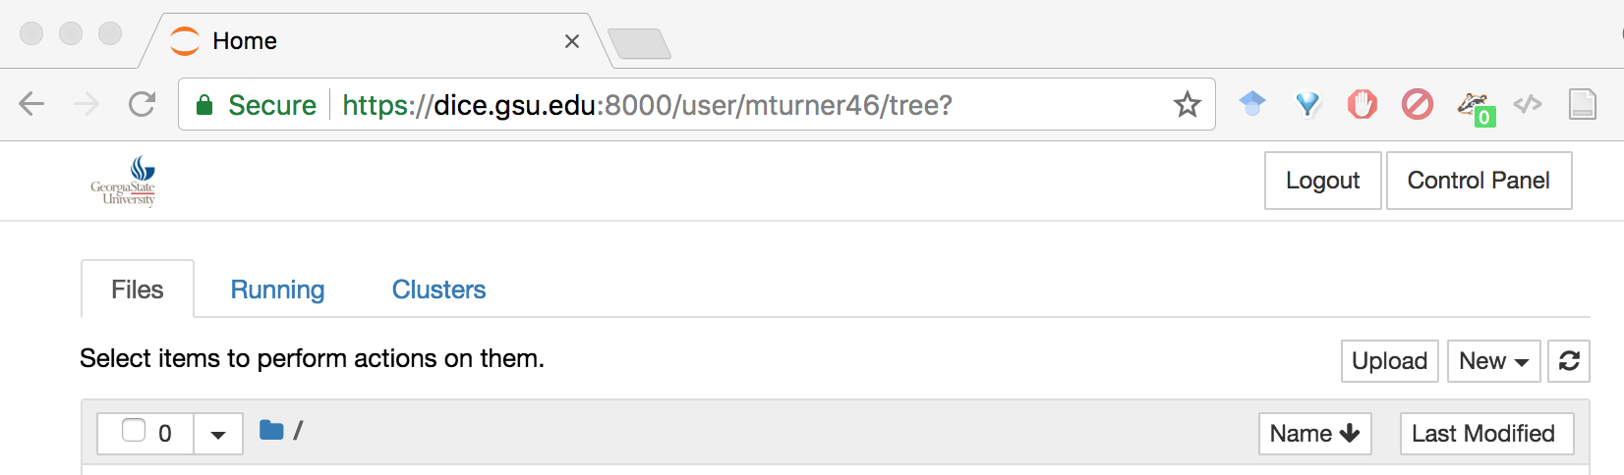
When you see a page where the TOP of the page looks like this, you are ready to start!

